Slide 1

Flutter Frenzy
2-Days Bootcamp
Brought to you by
GDSC UM
GDSC APU

Slide 2

Introduction to Flutter

Slide 3
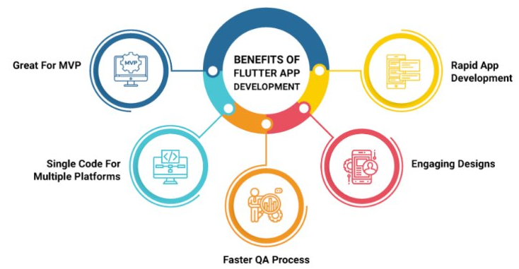
Why Flutter?

Slide 4
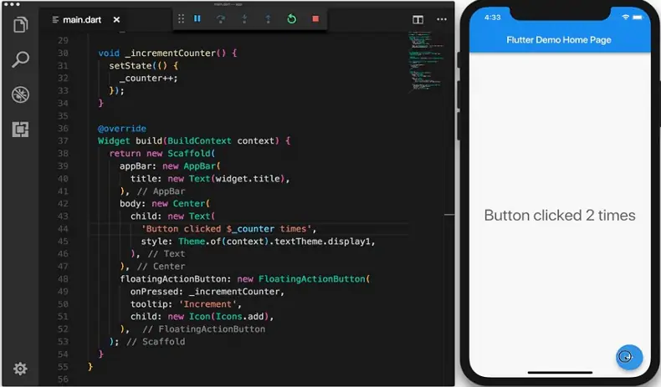
Benefits
Good for MVP + Engaging Design

Slide 5




Benefits
Faster QA Process - Native

Slide 6
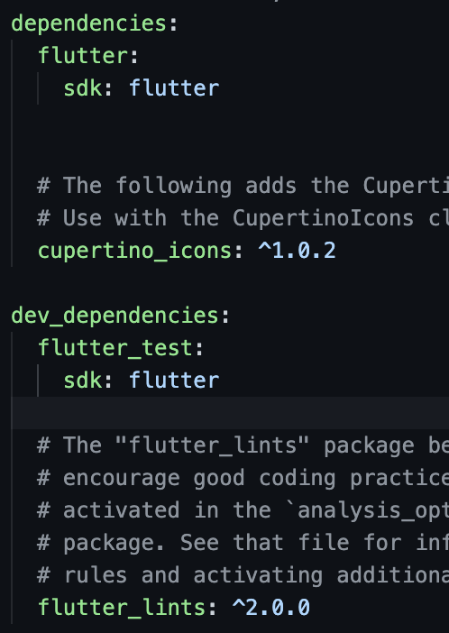
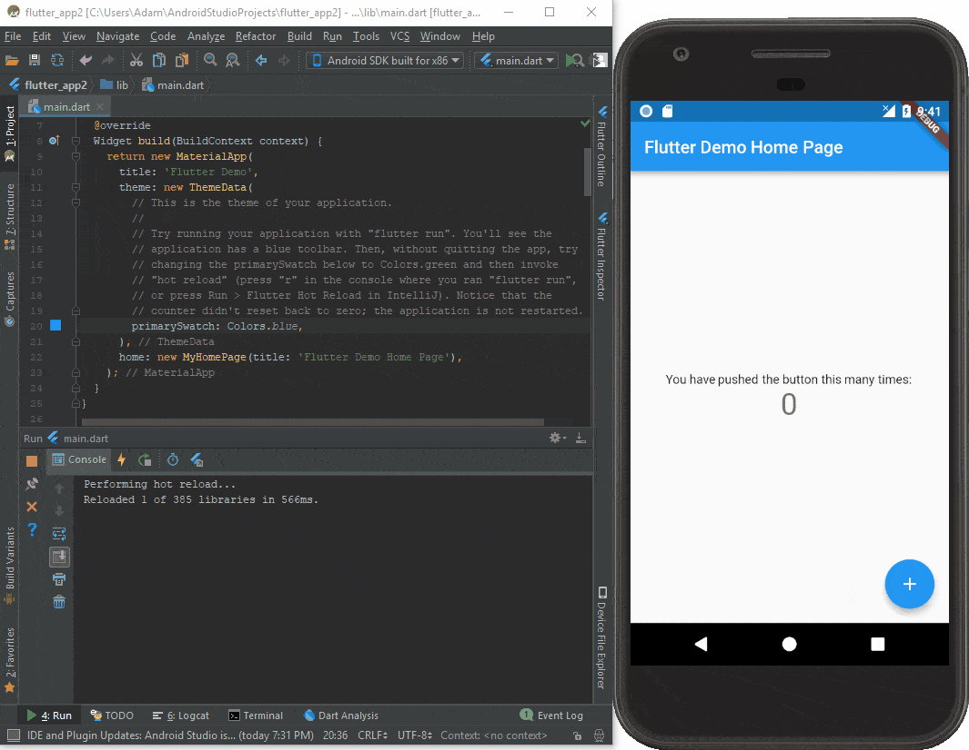




Benefits
Rapid App Development
Data Type Control
Hot Reload
Dependencies Control

Slide 7

Introduction to Dart

Slide 8
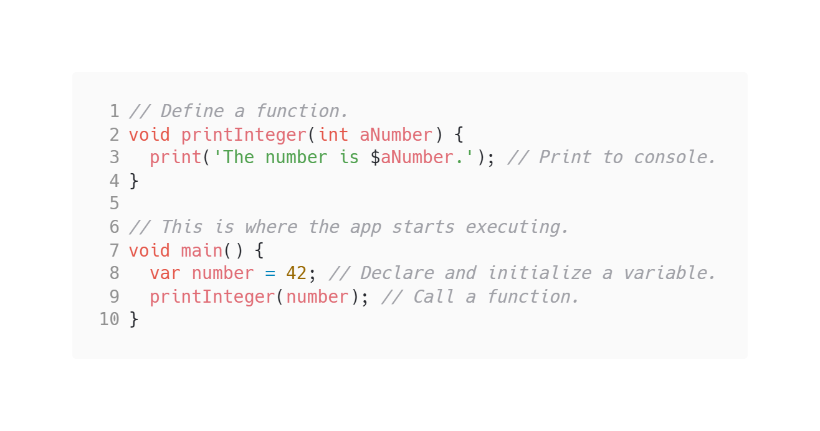
Dart - first program
Where can we start?

Slide 9
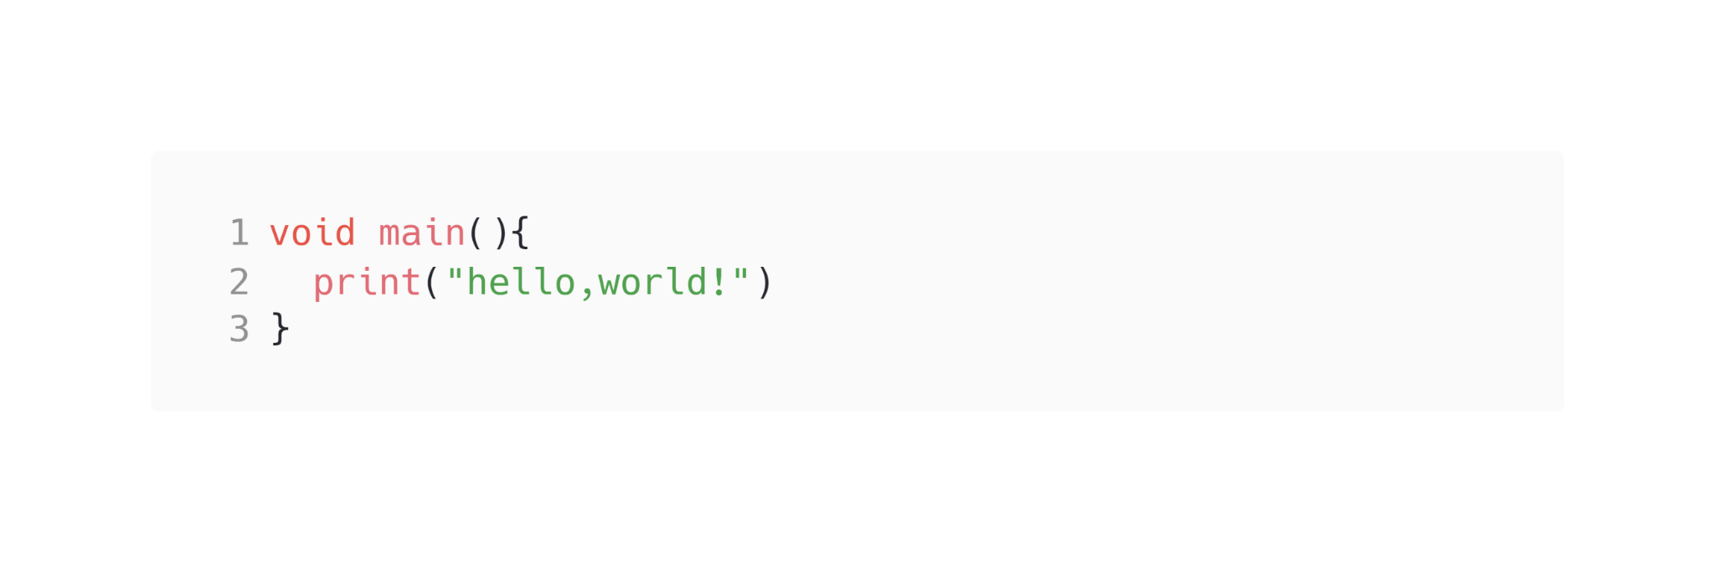
Dart - Hello World
First Function

Slide 10
Dart - Variables
Dart is strongly typed
Unlike Java, Dart doesn’t have the keywords public, protected, and private. If an identifier starts with an underscore (_), it’s private to its library.
By default, every variable in Dart should be assigned an initial value. But some of types are assigned automatically.

Slide 11
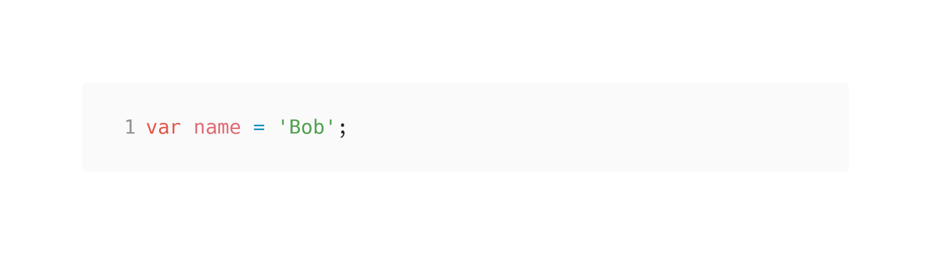

Dart - Variables

Slide 12
Dart - Variables
String “abc”
Int 1, -1, 0
Double 1.1
Set <string>{“ab”,”cd”}
Map {“hello”:”world”}
List [1,2,3,4]

Slide 13
Dart - Variables
Uninitialized variables that have a nullable type have an initial value of null. Even variables with numeric types are initially null, because numbers—like everything else in Dart—are objects.
(If you haven’t opted into null safety, then every variable has a nullable type.)

Slide 14

Dart - Variables
If you enable null safety, then you must initialize the values of non-nullable variables before you use them:

Slide 15
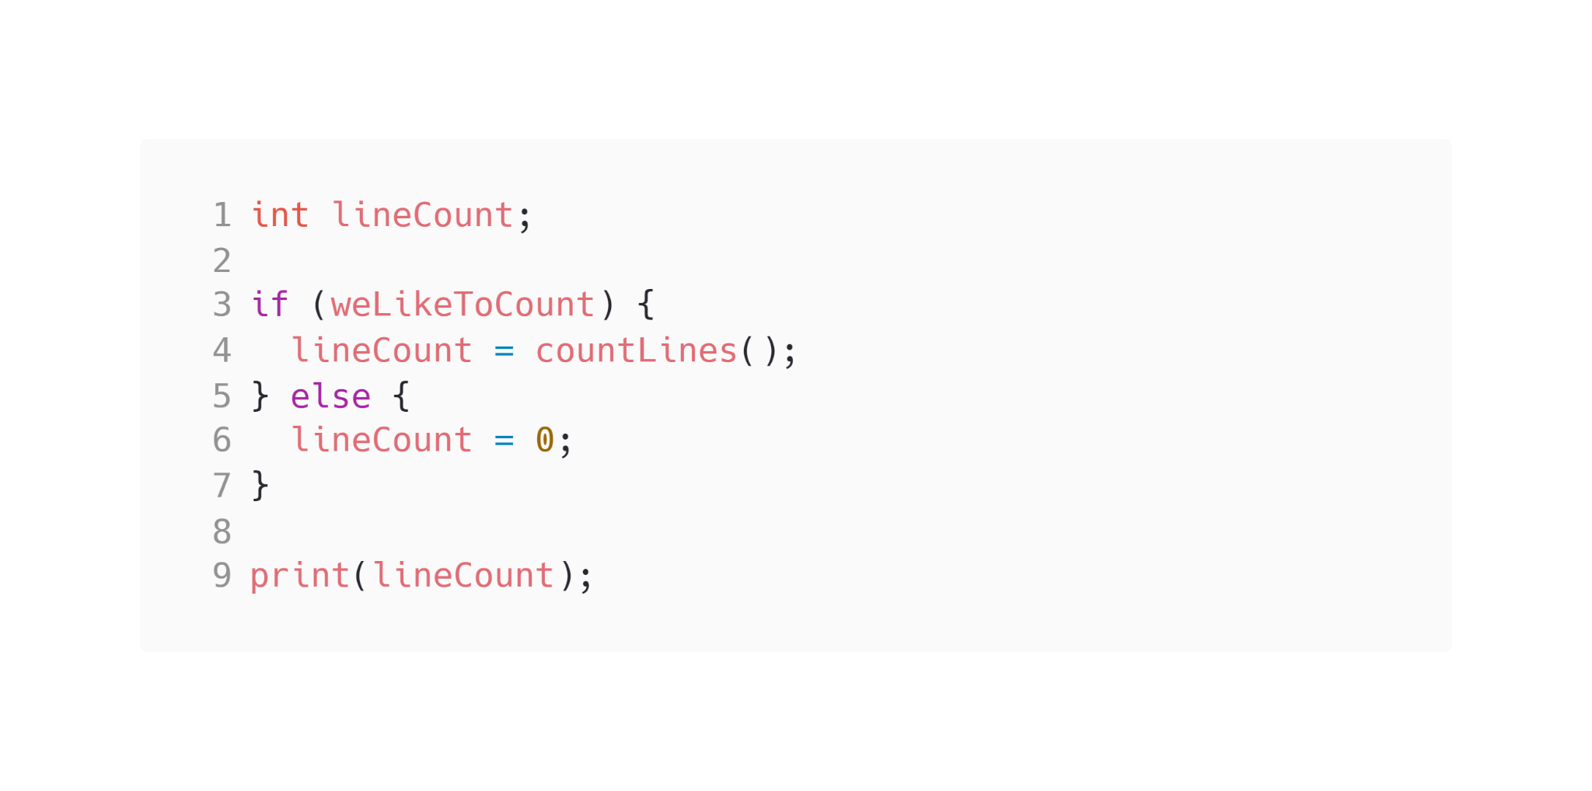
Dart - Variables
You don’t have to initialize a local variable where it’s declared, but you do need to assign it a value before it’s used. For example, the following code is valid because Dart can detect that lineCount is non-null by the time it’s passed to print():

Slide 16
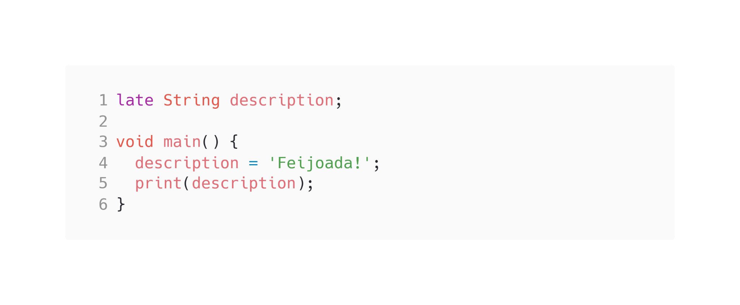
Dart - Variables
Dart 2.12 added the late modifier, which has two use cases:
Declaring a non-nullable variable that’s initialized after its declaration.
Lazily initializing a variable.

Slide 17
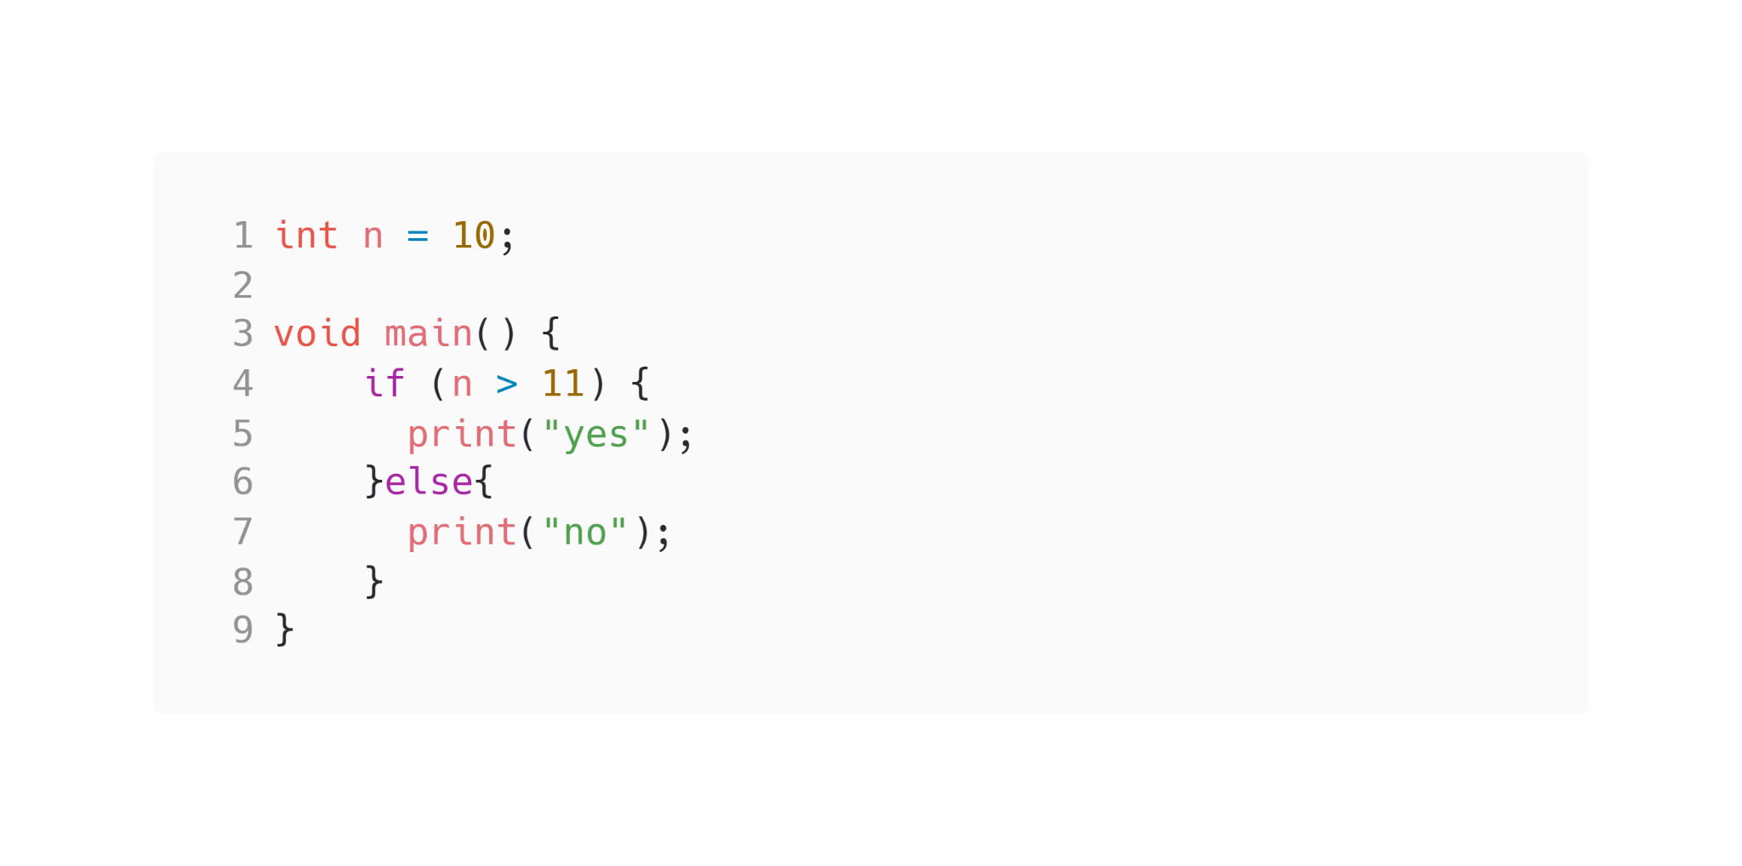
Dart - IF statement

Slide 18
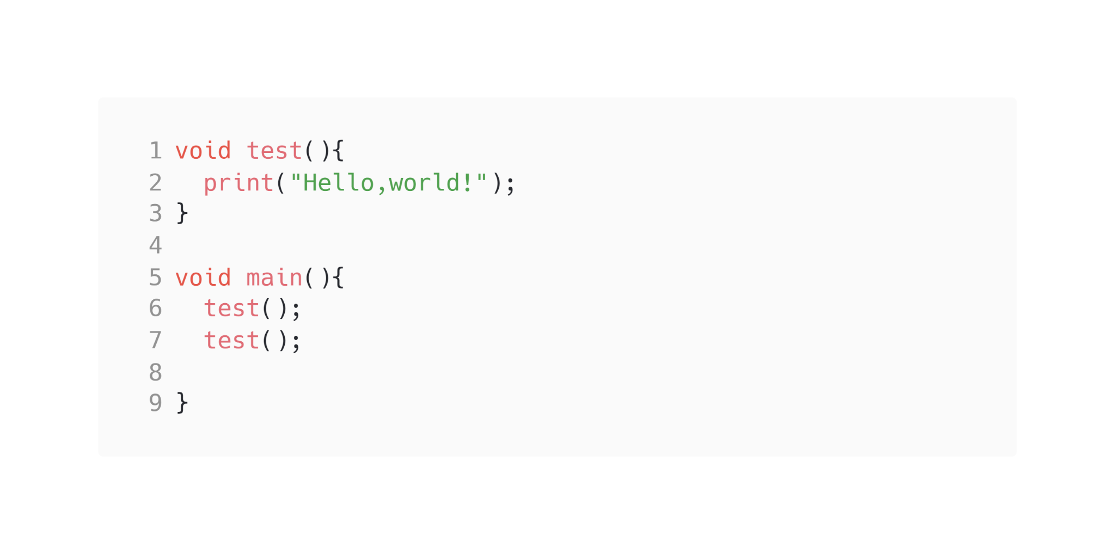
Dart - Functions
Dart is a true object-oriented language, so even functions are objects and have a type, Function. This means that functions can be assigned to variables or passed as arguments to other functions.

Slide 19
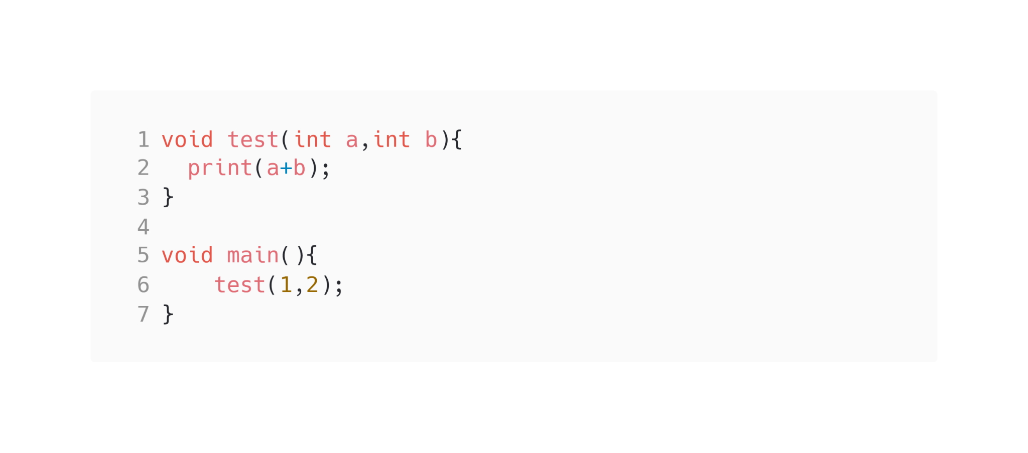
Dart - Functions
Dart functions are also integrated with parameters. Usually parameters are variables that users pass the value when invoking the function.

Slide 20
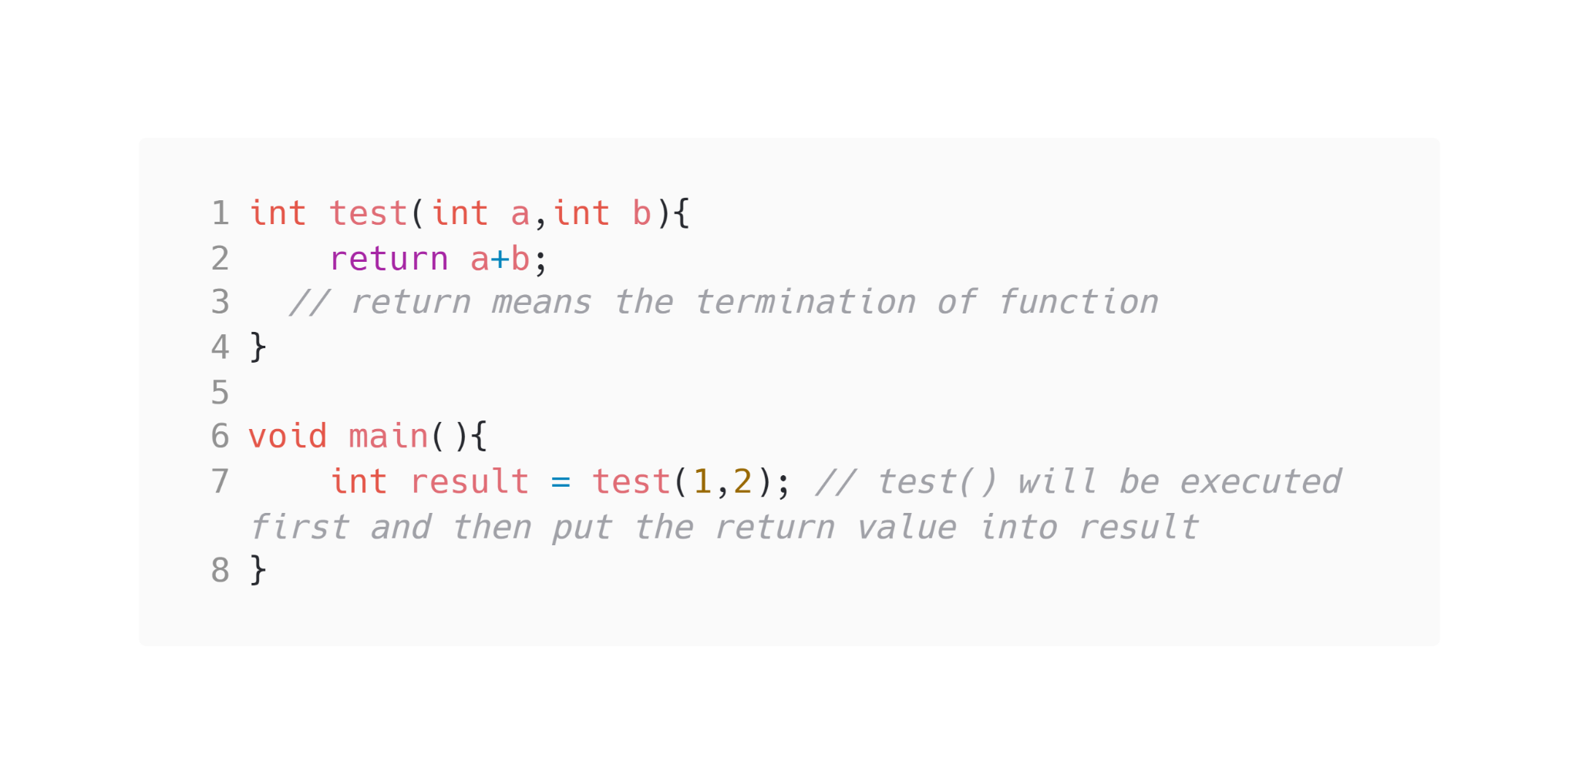
Dart - Functions
Dart functions are also integrated with parameters. Usually parameters are variables that users pass the value when invoking the function.

Slide 21
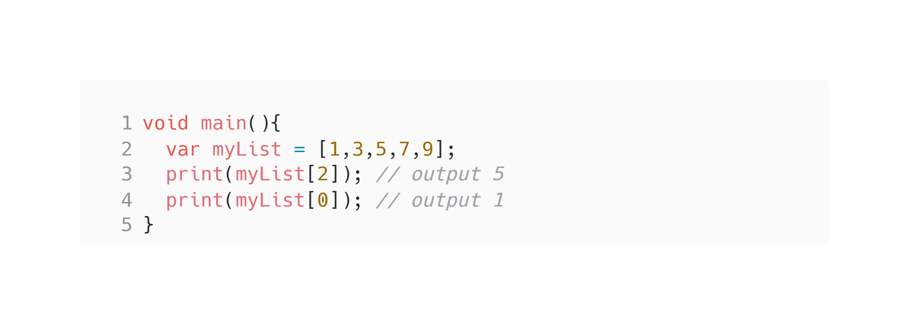
Dart - List

Slide 22
Dart - Loop
For loop in Dart is similar to that in Java and also the flow of execution is the same as that in Java.
for(initialization; condition; text expression){
// Body of the loop
}

Slide 23
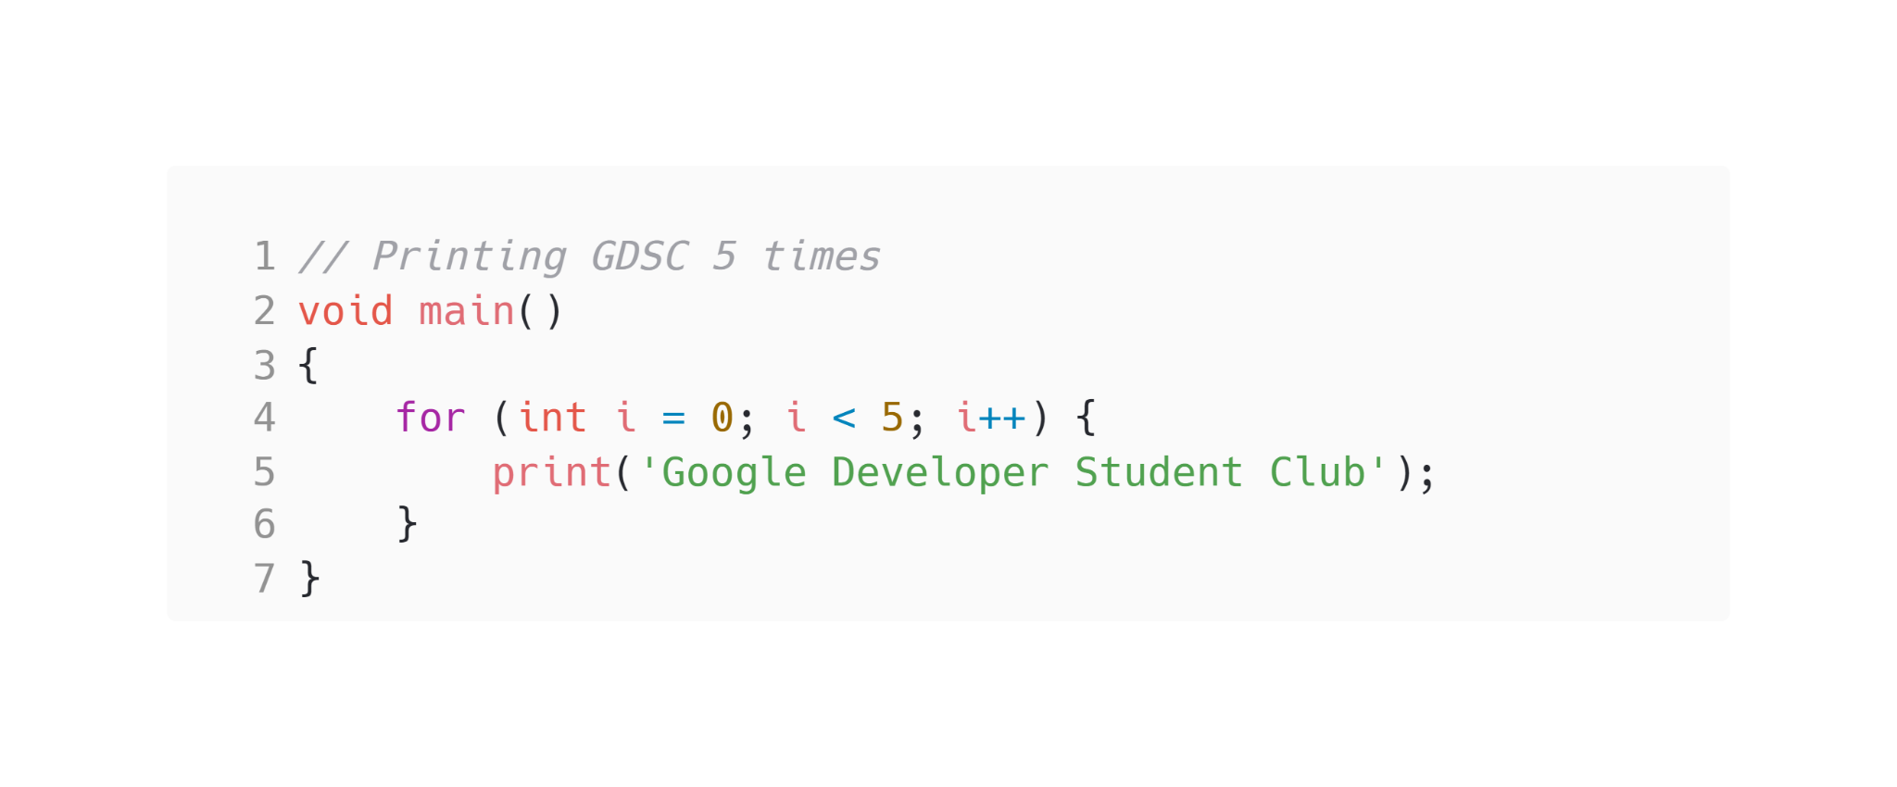
Dart - Loop
For loop in Dart is similar to that in Java and also the flow of execution is the same as that in Java.

Slide 24
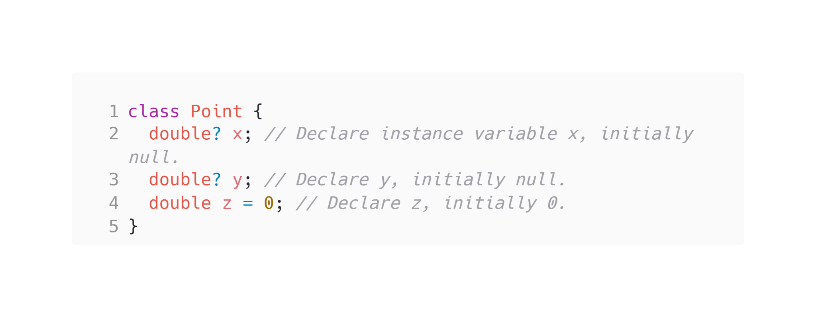
Dart - Class
Dart is an object-oriented language with classes. Every object is an instance of a class, and all classes except Null descend from Object.

Slide 25
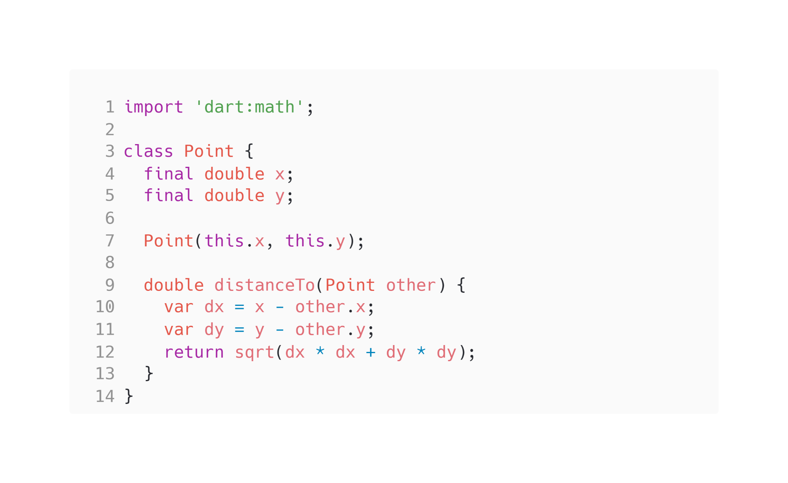
Dart - Methods
Methods are functions in class. Instance methods on objects can access instance variables and this. The distanceTo() method in the following sample is an example of an instance method:

Slide 26
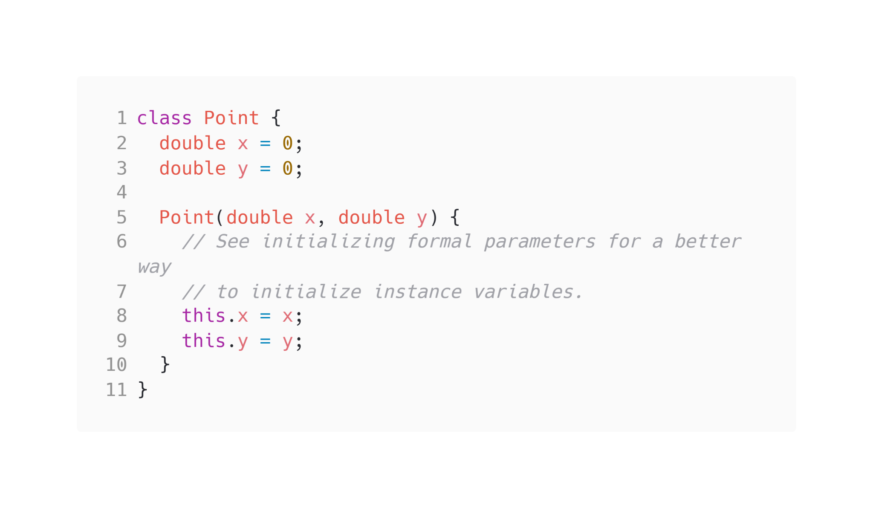
Dart - Constructor
Constructor is an instance method that will be executed when the class is instantiated
Usually the name of constructor will be the same as its class.

Slide 27
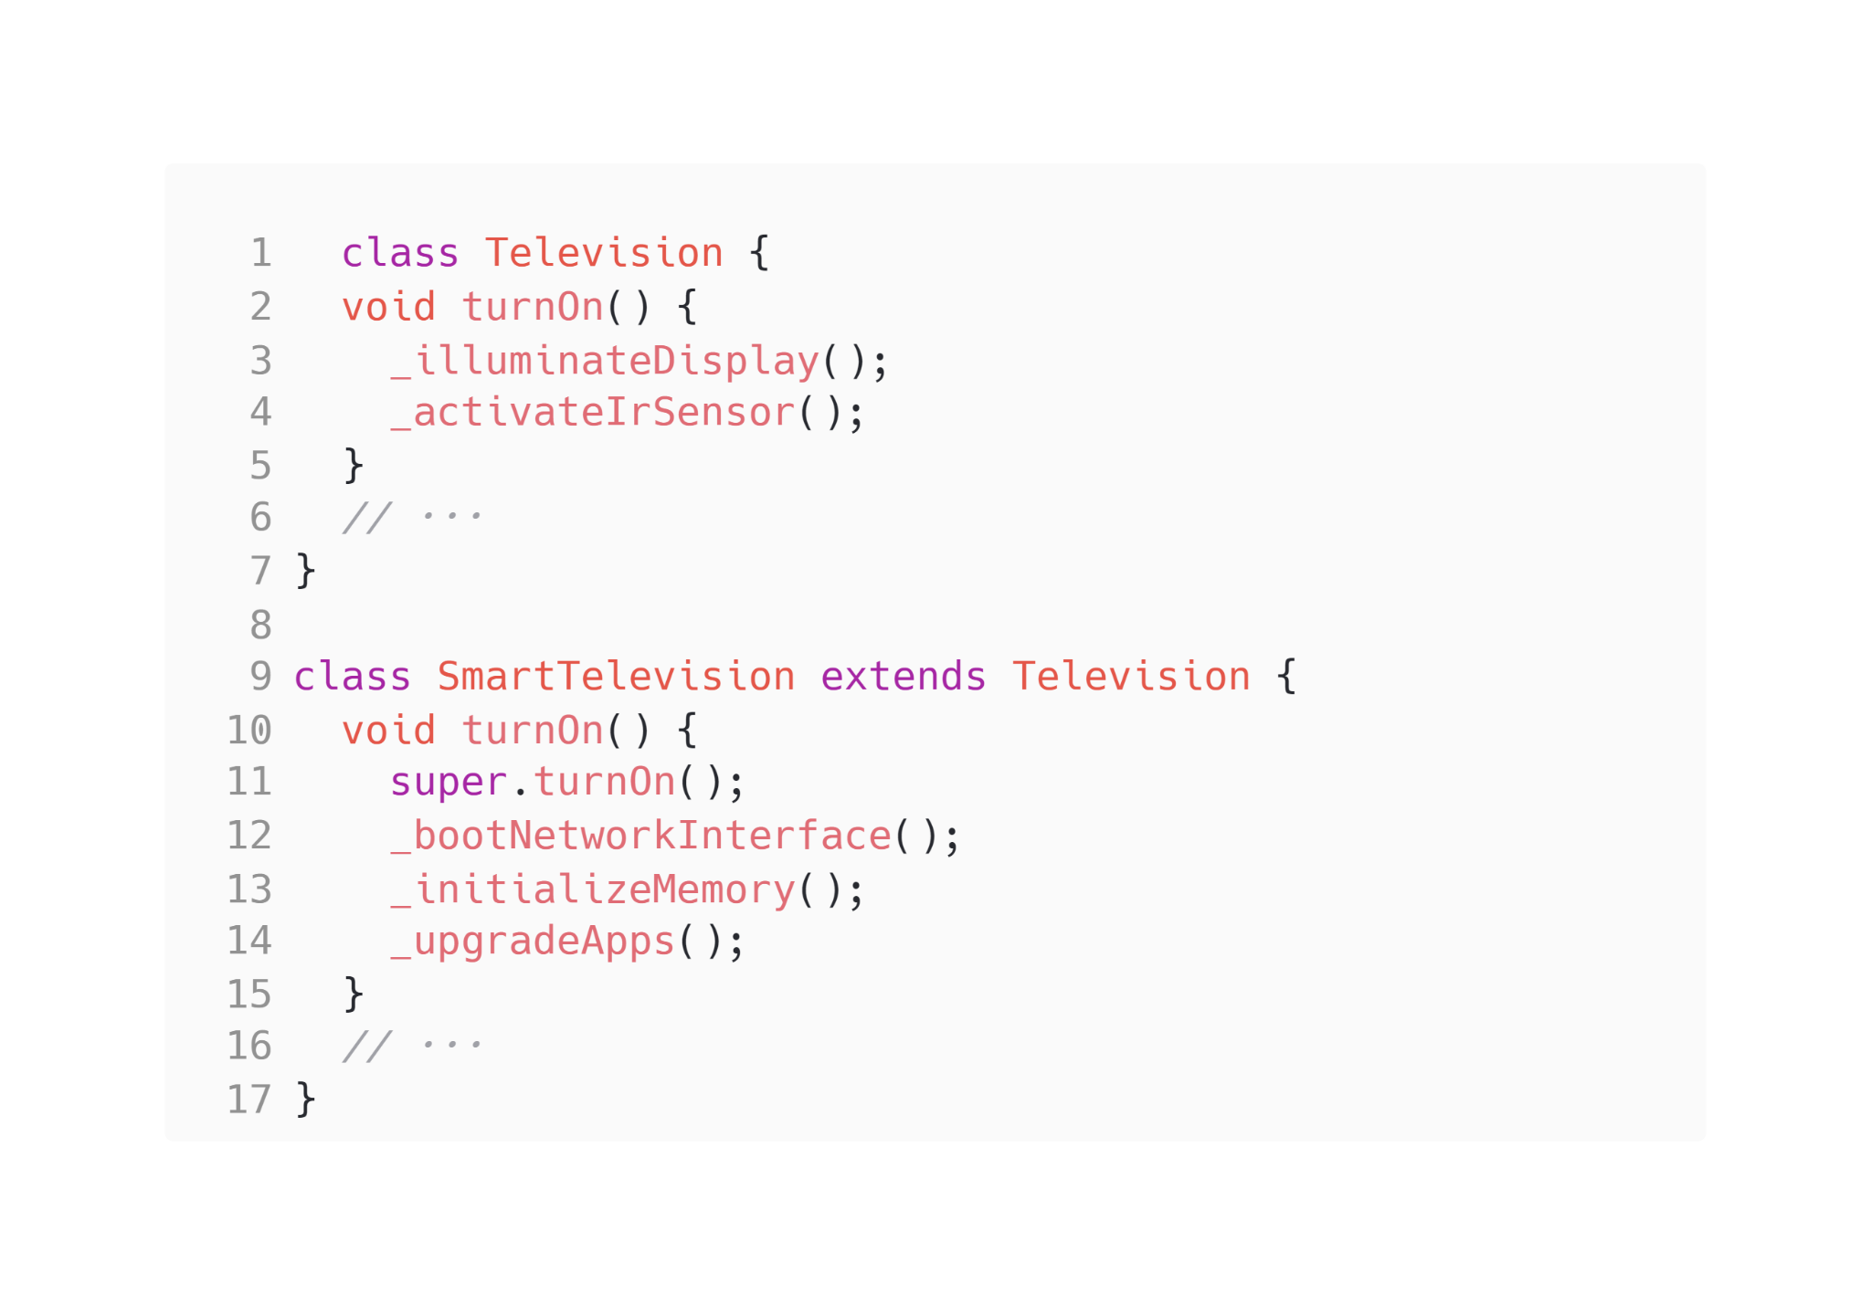
Dart - Extension
Use extends to create a subclass, and super to refer to the superclass:

Slide 28
Widgets (Stateless)

Slide 29
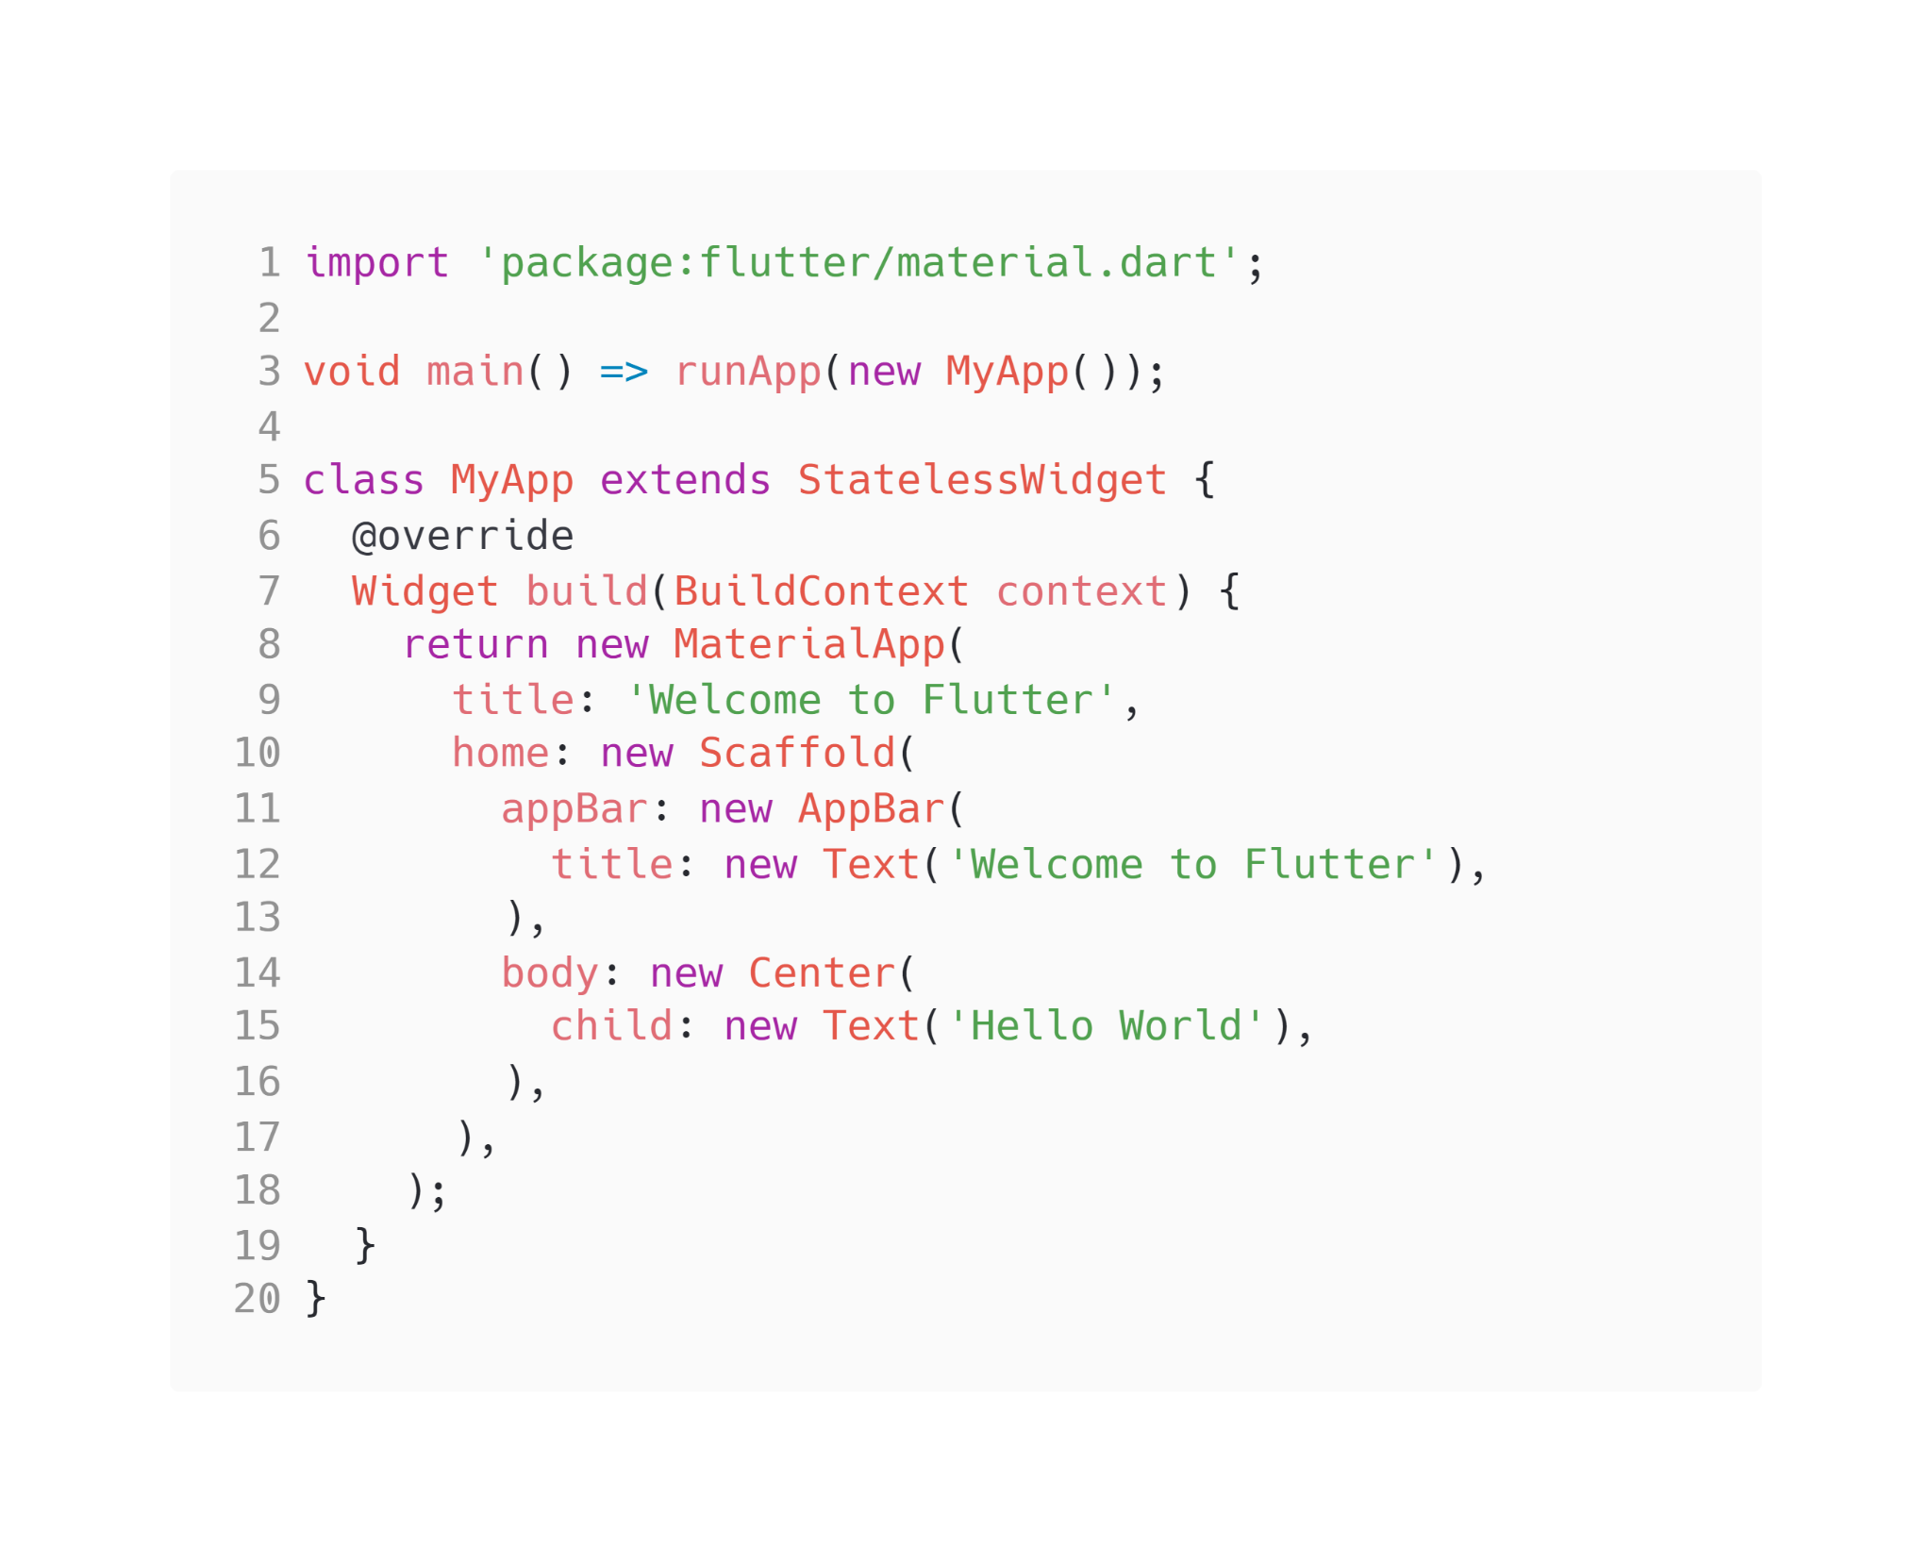
Start your first program
main(): Where the app starts to run
MyApp: StatelessWidget
MaterialApp: A class(widget) to generate a material design interface
Title
Body
appbar

Slide 30
Start your first program
main(): Where the app starts to run
MyApp: StatelessWidget
MaterialApp: A class(widget) to generate a material design interface
Title
Body
appbar

Slide 31
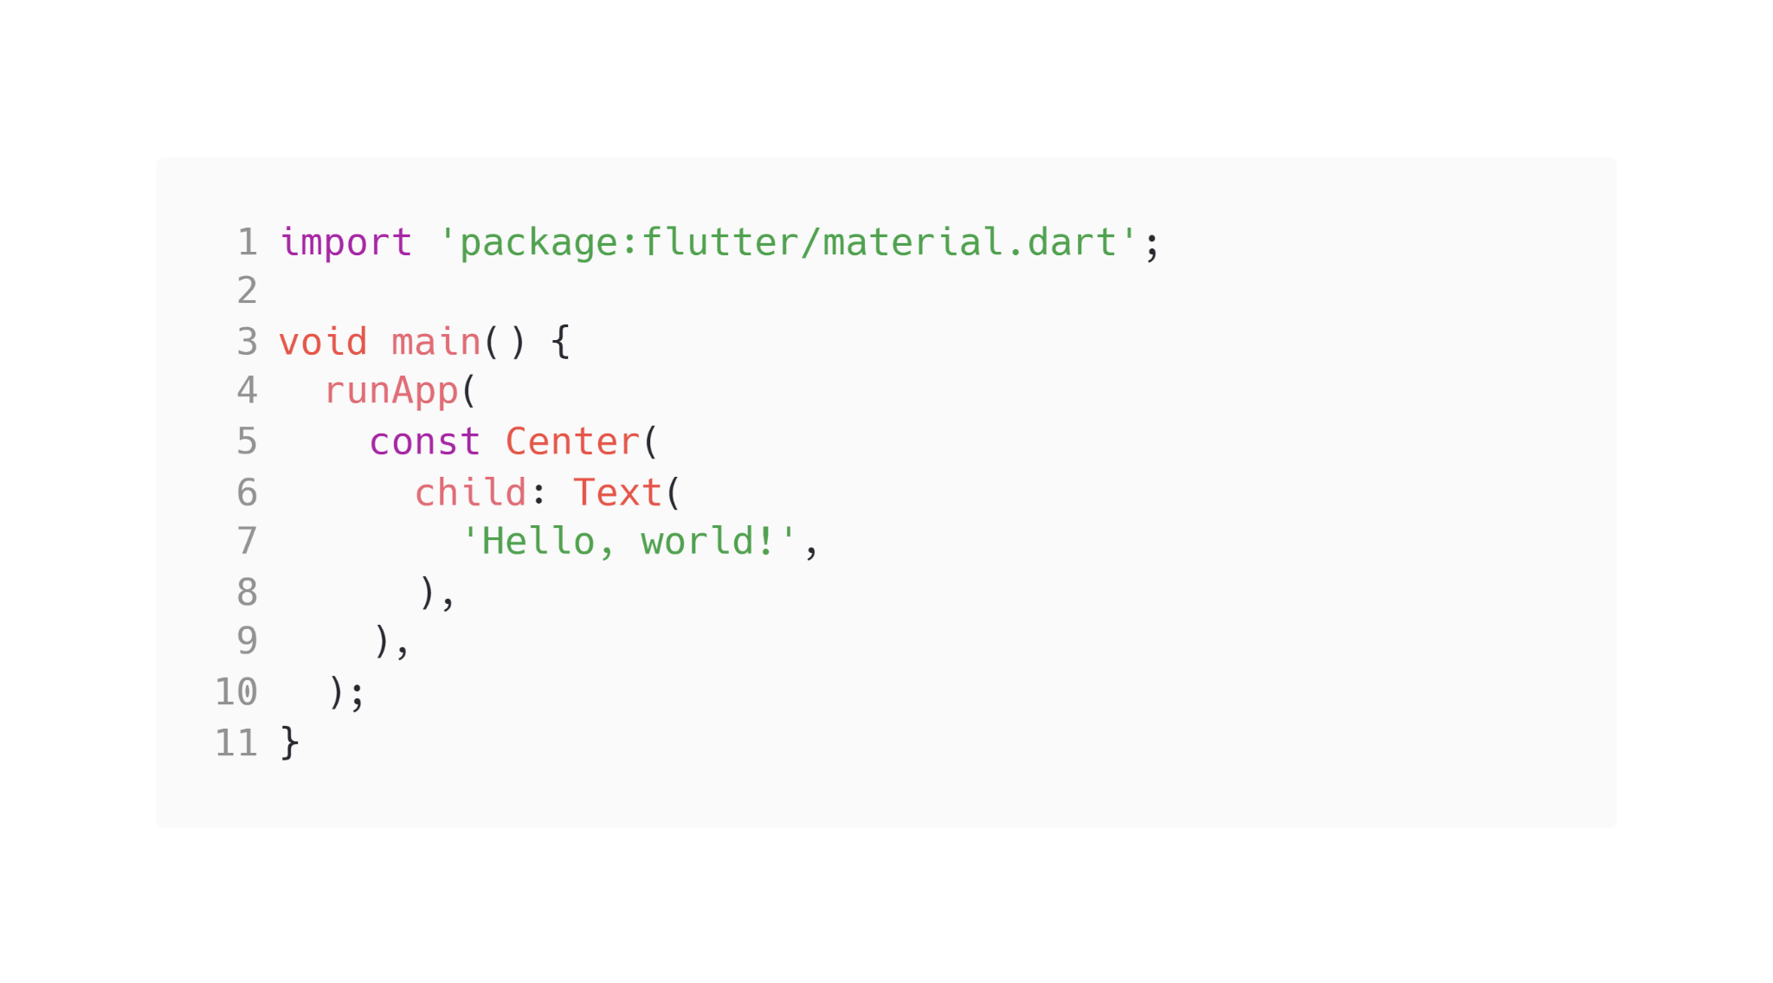
Text

Slide 32
Text

Slide 33
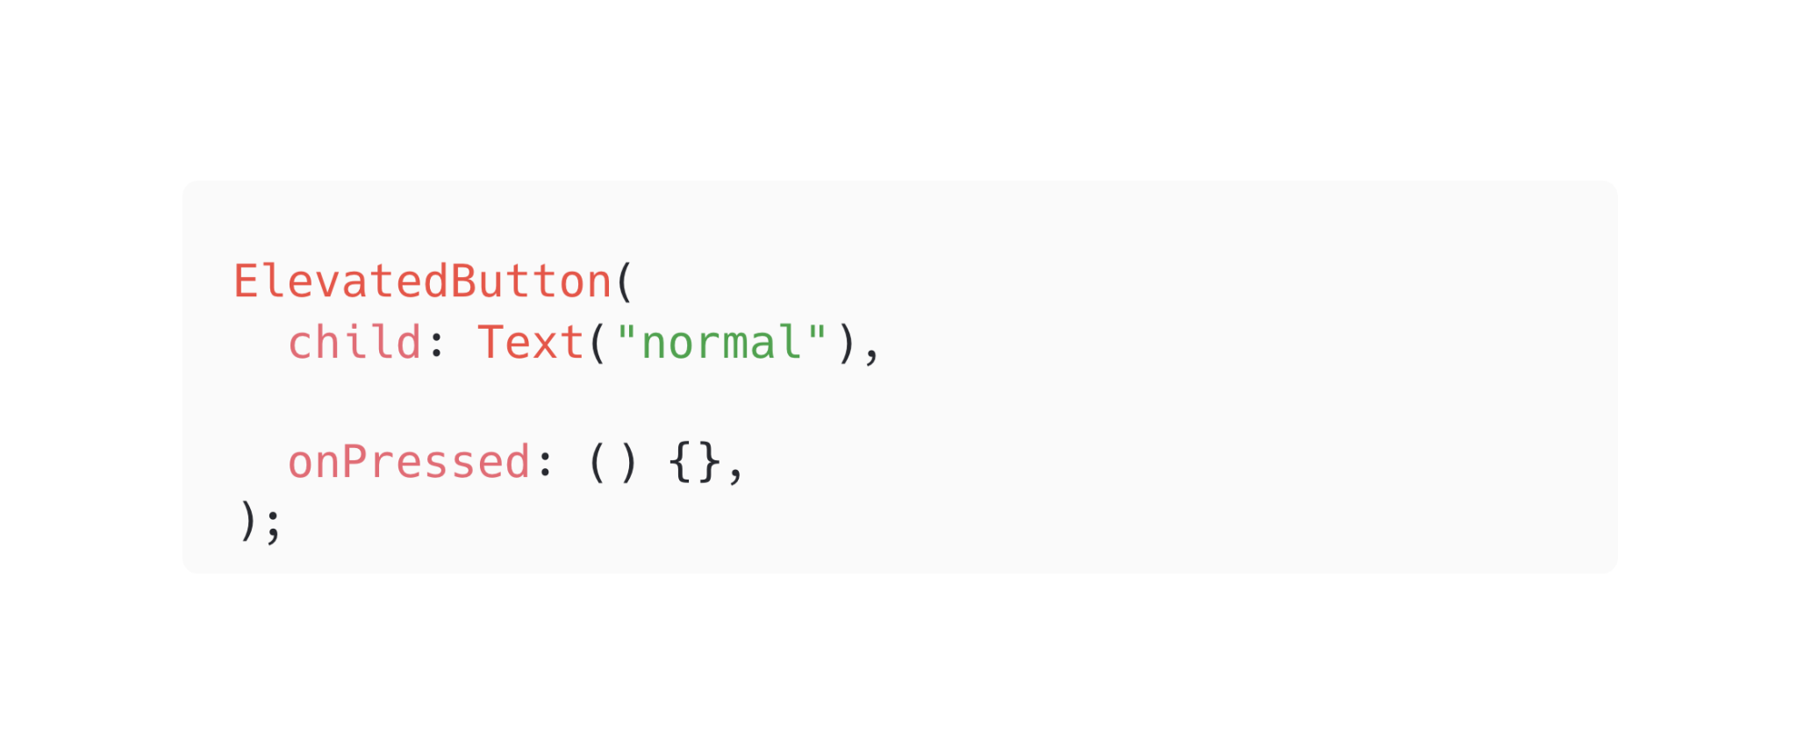
Button

Slide 34
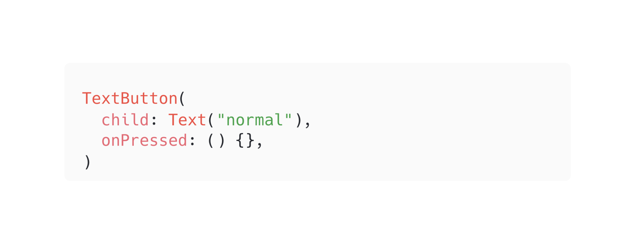
Button

Slide 35
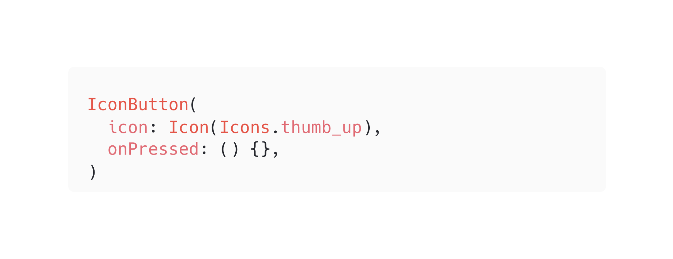
Button

Slide 36

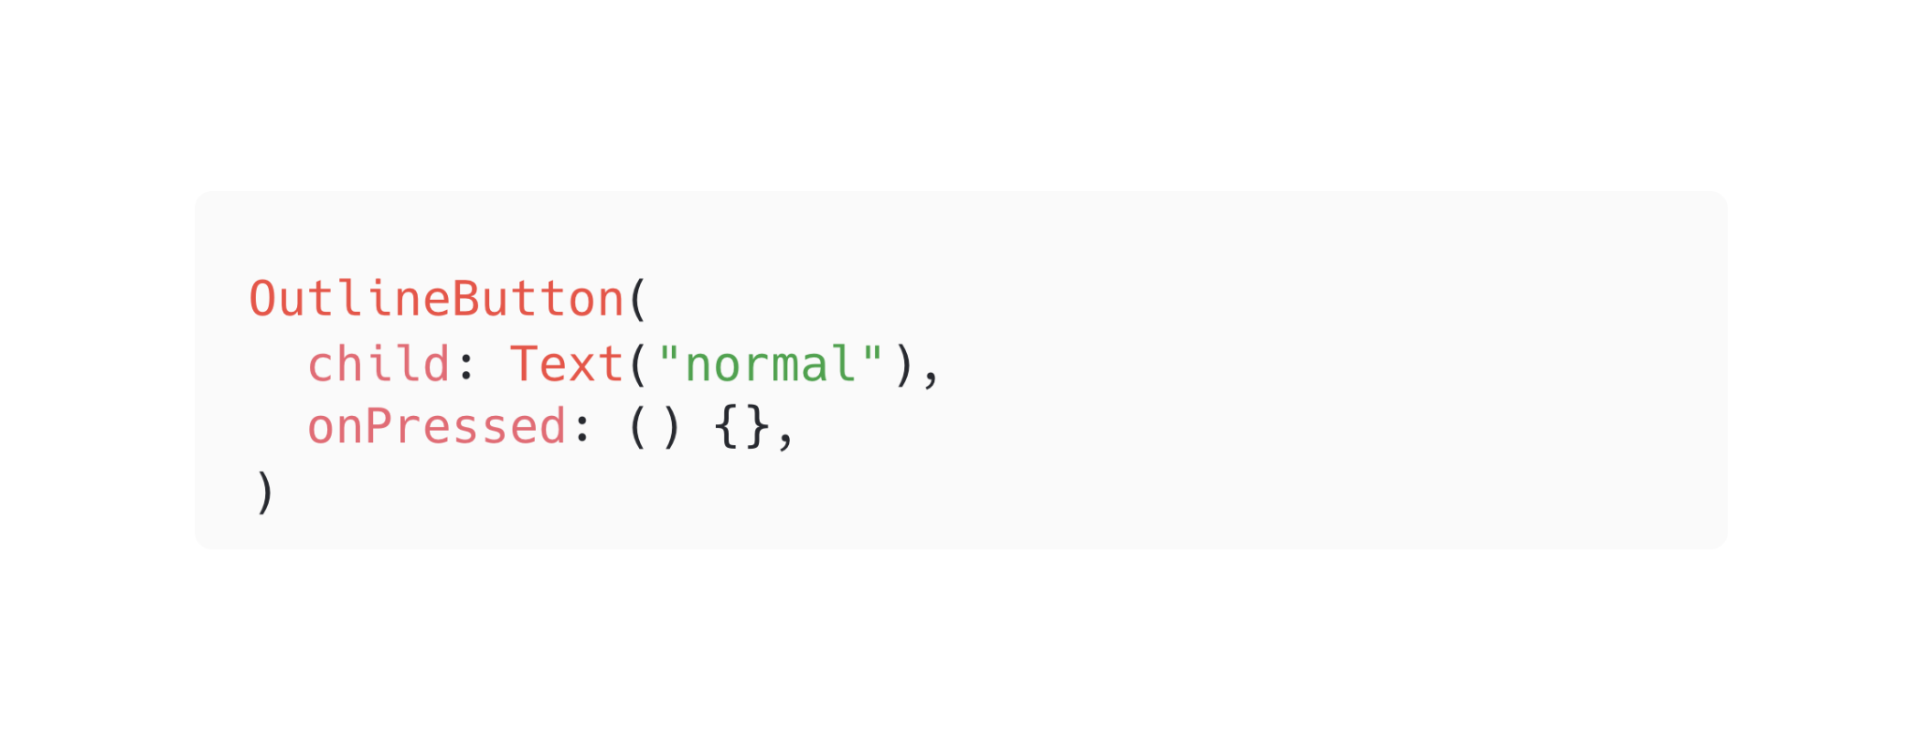
Button

Slide 37
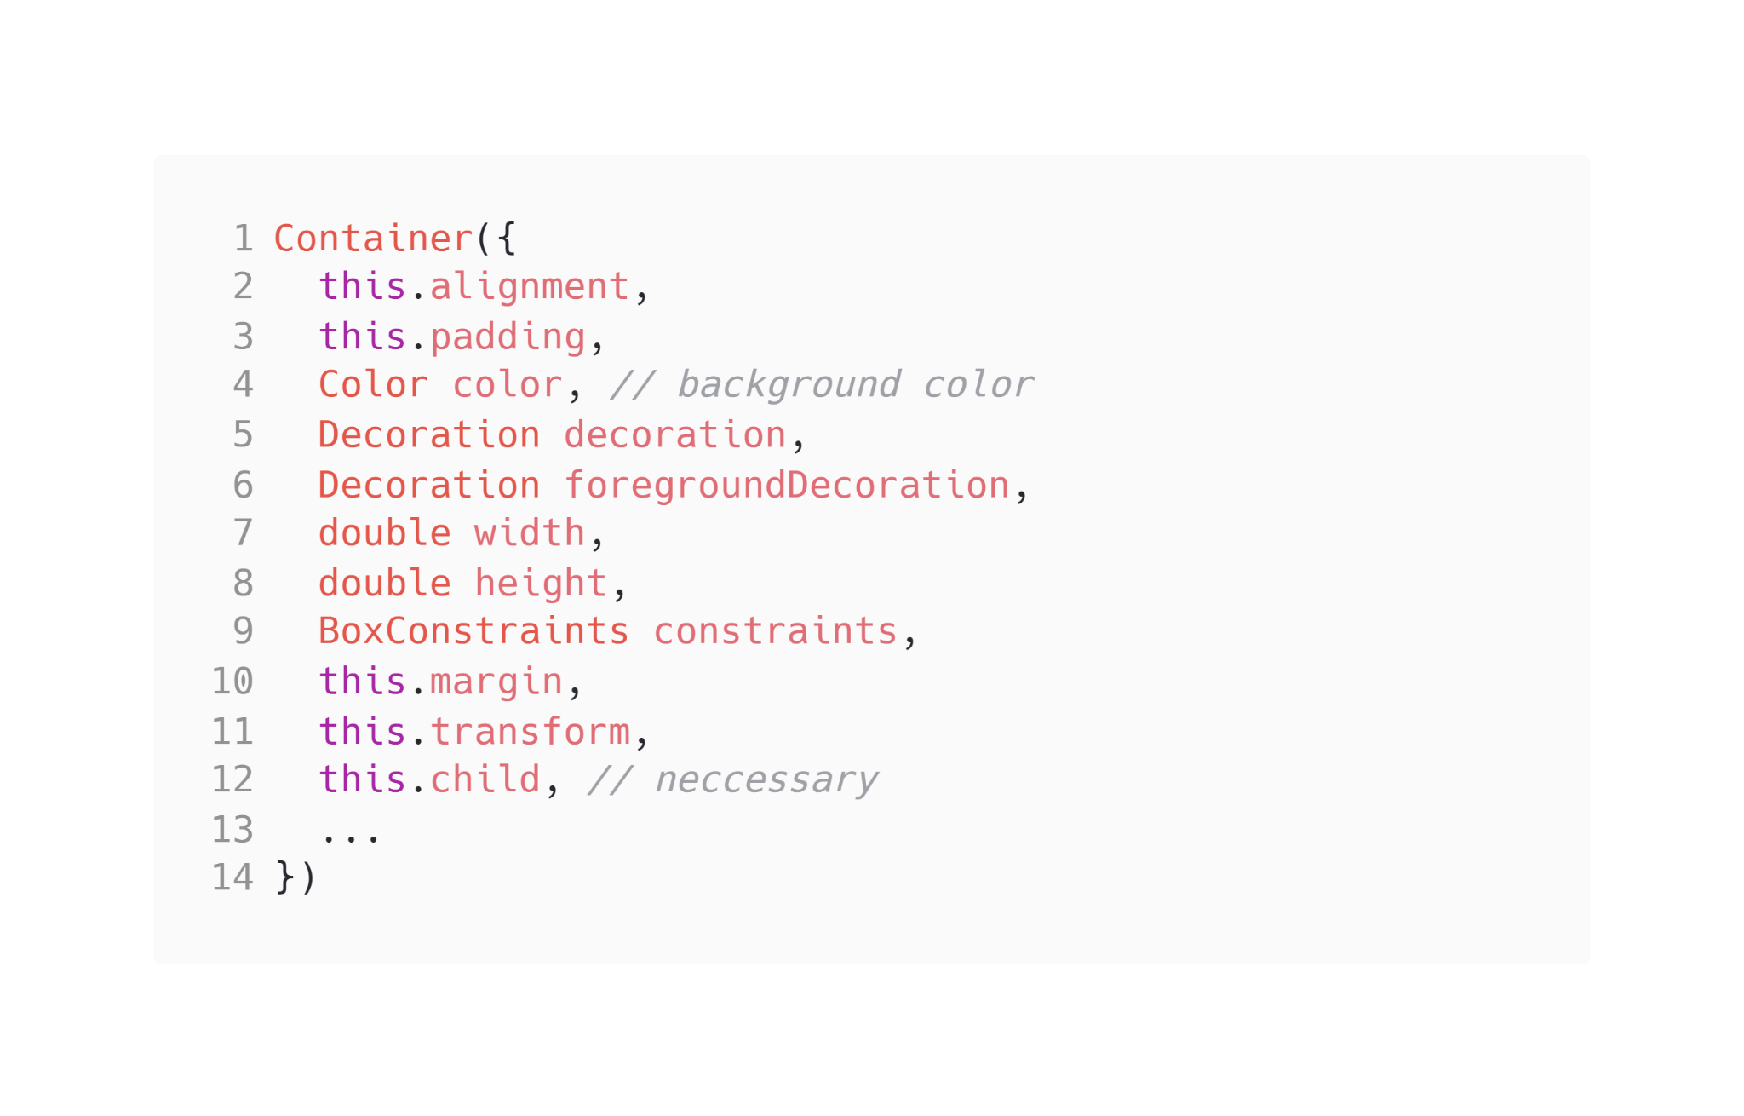
Container

Slide 38
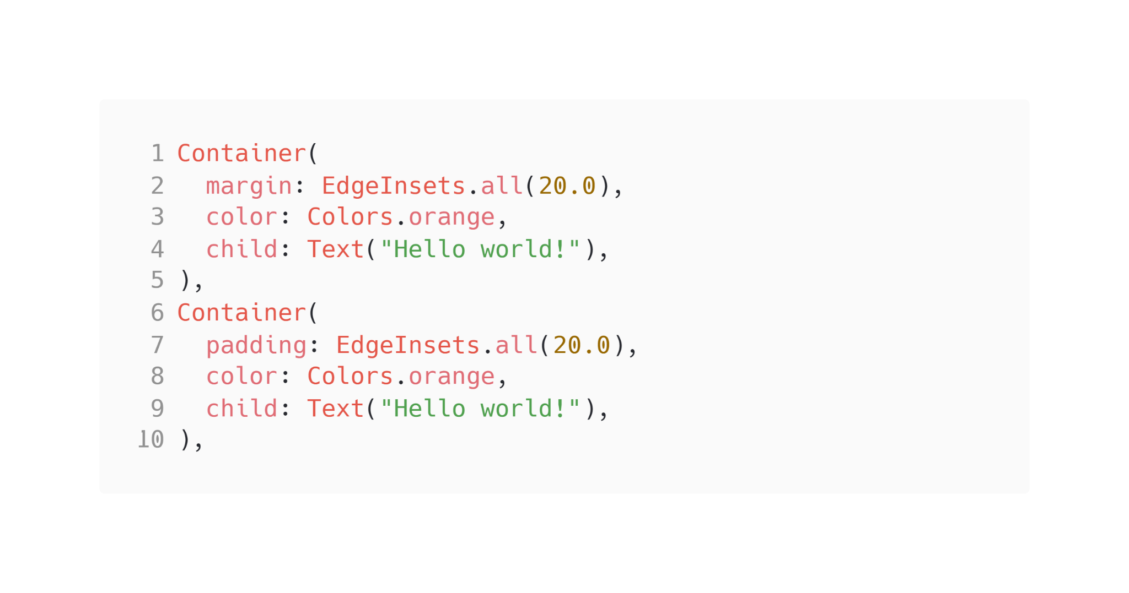
Container

Slide 39
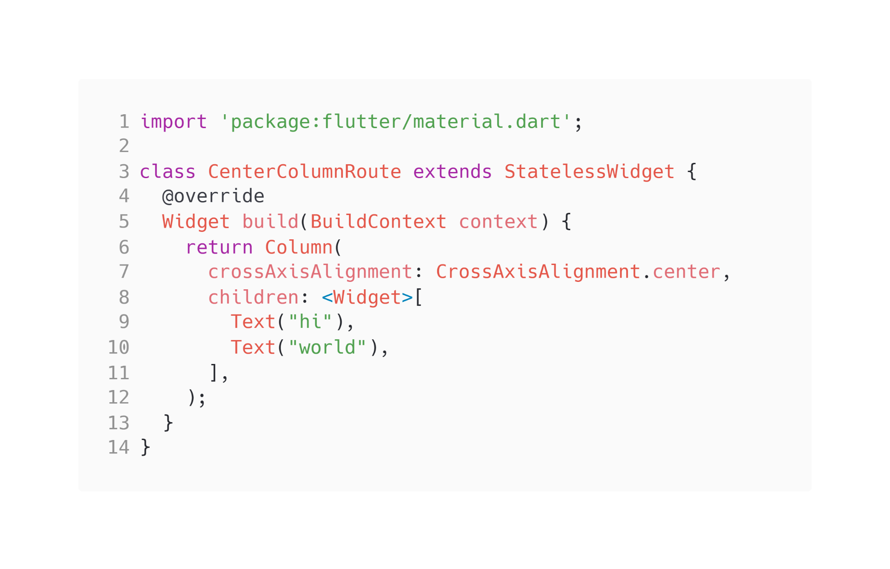
Column & Row

Slide 40
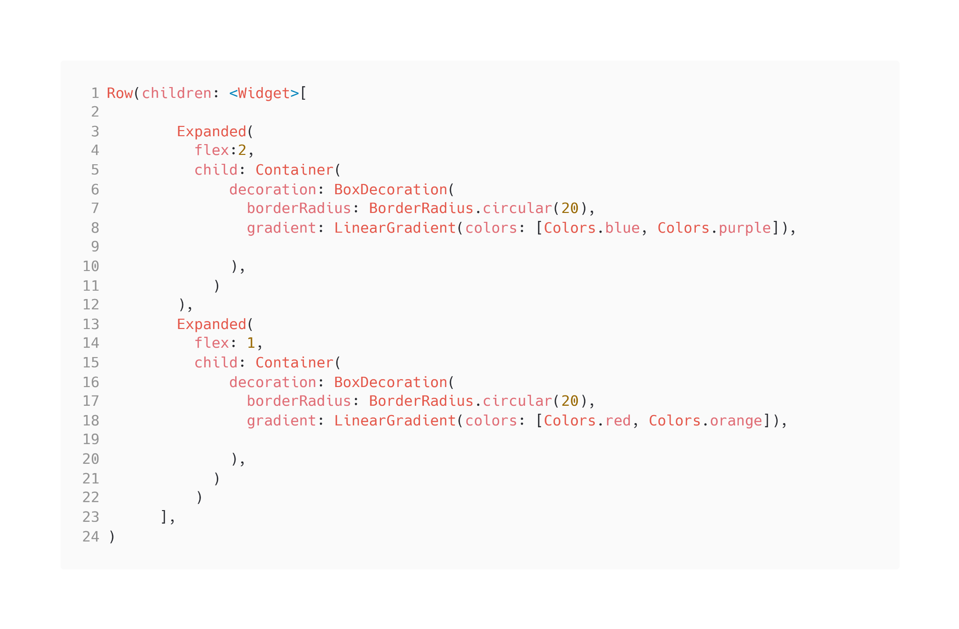
Expanded

Slide 41

Firebase x Flutter
By Raeveen Pasupathy

Slide 42
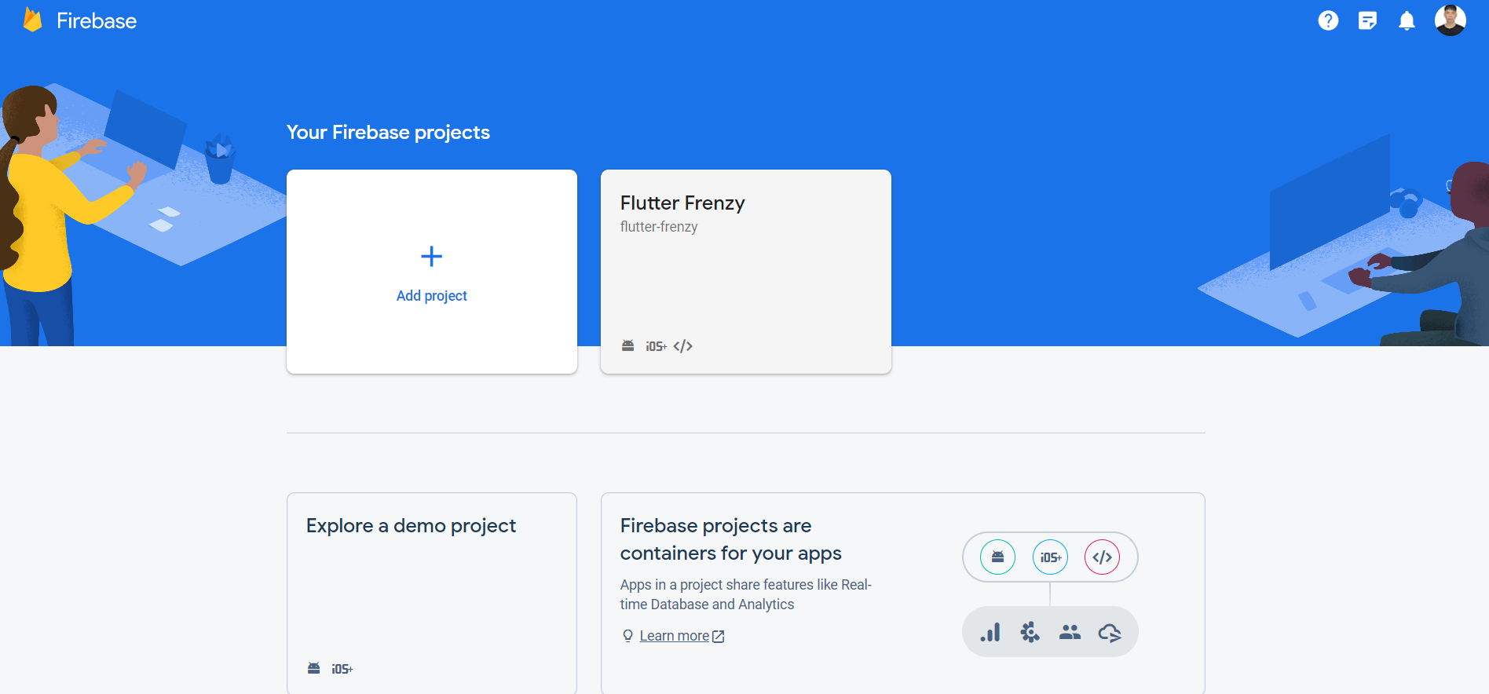
What are we learning
Getting started on Firebase Console.
Authentication Flow in Flutter.
Introducing FlutterFire.
Building a simple app with Firebase authentication.

Slide 43
What is FlutterFire
FlutterFire is a CLI tool that allows you to seamlessly integrate Firebase with your Flutter app.

Slide 44
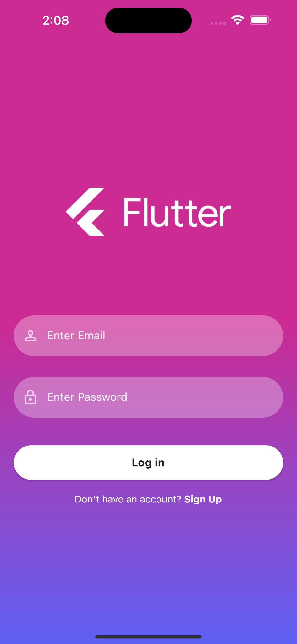
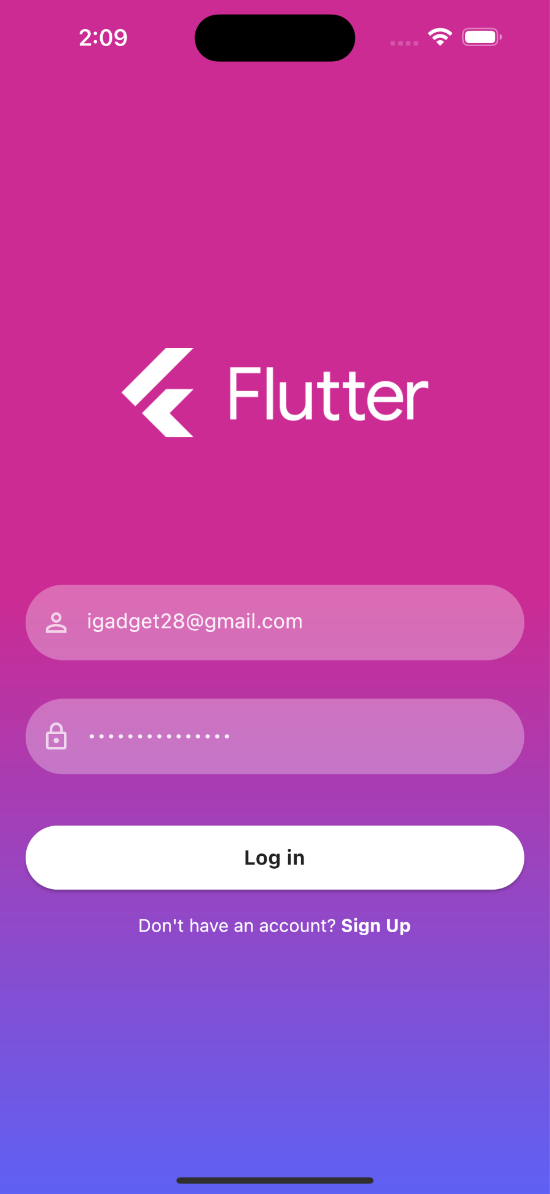
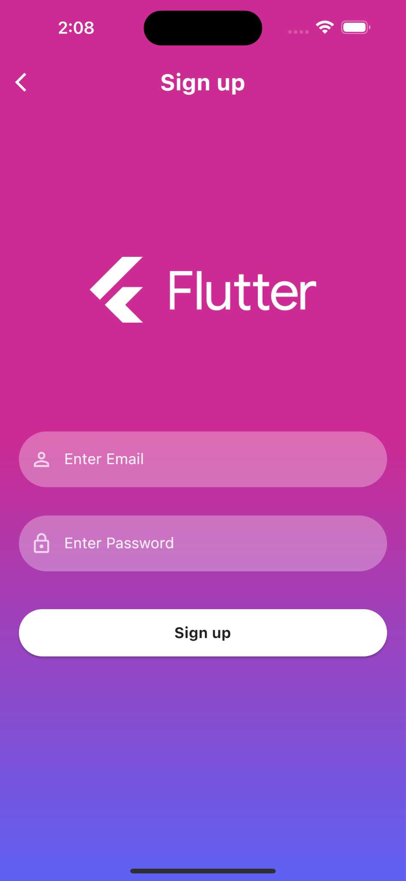

Our Simple App (Final look)

